Slide 1
LU Factorization using GPU
By Van Quach Dinh, Andy Yang

Slide 2
Introduction
Primary ways to solve systems of linear equations include:
Substitution
Gaussian elimination
Inverse Matrix method
LU Factorization

Slide 3
LU factorization Basics
Given Ax = b, decompose matrix A to L * U matrices
Substitute LU for A -> L (Ux) = b; Set Ux= y
L (y) = b ➡ Apply forward substitution to get y
Ux = y ➡ Apply backward substitution to get x
A₀₀ | A₀₁ | A₀₂
A₁₀ | A₁₁ | A₁₂
A₂₀ | A₂₁ | A₂₂
L₀₀ | 0 | 0
L₁₀ | L₁₁ | 0
L₂₀ | L₂₁ | L₂₂
U₀₀ | U₀₁ | U₀₂
0 | U₁₁ | U₁₂
0 | 0 | U₂₂
A₀ =
L₀=
U₀=

Slide 4
Standard LU Decomposition
Calculate the first row of U given L₀₀ = 1
A₀₀ = L₀₀U₀₀ ➡ U₀₀ = A₀₀ /1 = 8 A₀₁ = L₀₀ U₀₁ ➡ U₀₁ = A₀₁/1 = 1
A₀₂ = L₀₀ U₀₂➡ U₀₂ = A₀₂ /1 = 7
Calculate the first column of L given U₀₀= 8
L₁₀ = A₁₀ / U₀₀ ➡ 4 / 8 = 0.5
L₂₀ = A₂₀ / U₀₀ ➡ = 6 / 8 = 0.75
8 | 1 | 7
4 | 2 | 9
6 | 3 | 10
1 | 0 | 0
L₁₀ | 1 | 0
L₂₀ | L₂₁ | 1
U₀₀ | U₀₁ | U₀₂
0 | U₁₁ | U₁₂
0 | 0 | U₂₂
A₀ =
=
X

Slide 5
Find the Sub-Matrix A₁
8 | 1 | 7
4 | 2 | 9
6 | 3 | 10
1 | 0 | 0
0.5 | 1 | 0
0.75 | L₂₁ | 1
8 | 1 | 7
0 | U₁₁ | U₁₂
0 | 0 | U₂₂
A₀ =
=
X
A₀ = [ 0.5 0.75] ^{T} [1 7] + L₁ U₁
A₁ = A₀ - [ 0.5 0.75] ^{T} [1 7] = L₁ U₁
1.5 | 5.5
2.25 | 4.75
2 | 9
3 | 10
0.5 | 3.5
0.75 | 5.25
__
=

Slide 6
Decompose Sub-Matrix A₁
Repeat the process:
Calculate the first row of U in parallel given L₁₁ = 1
A₁₁ = L₁₁U₁₁ ➡ U₁₁ = 1.5 A₁₂ = L₁₁U₁₂ ➡ U₁₂ = 5.5
Calculate the first column of L in parallel given U₁₁= 1.5
A₂₁ = L₂₁U₁₁ ➡ L₂₁ = A₂₁ / U₁₁ = 1.5
1.5 | 5.5
2.25 | 4.75
1 | 0
L₂₁ | 1
U₁₁ | U₁₂
0 | U₂₂
A₁ =
=
X

Slide 7
Find the Sub-Matrix A₂
1.5 | 5.5
2.25 | 4.75
1 | 0
1.5 | 1
1.5 | 5.5
0 | U₂₂
A₁ =
=
X
A₁ = [1.5] ^{T} [5.5] + L₂U₂
A₂ = A₁ - [1.5] ^{T} [5.5] = L₂ U₂
A₂ = 4.75 - 8.25 =
-3.5

Slide 8
Termination Condition
A₂ =
=
X
-3.5
1
U₂₂
Done: when L_{n}U_{n} is 1 x 1, U₂₂ = - 3.5
The end result for the LU Decomposition would look like the following :
8 | 1 | 7
4 | 2 | 9
6 | 3 | 10
1 | 0 | 0
0.5 | 1 | 0
0.75 | 1.5 | 1
8 | 1 | 7
0 | 1.5 | 5.5
0 | 0 | -3.5
A₀ =
=
X

Slide 9
Block LU Decomposition
A₀ =
A₀₀ | A₀₁
A₁₀ | A₁₁
L₀₀⁰ | 0
L₁₀ | L₁₁
0 ^{U} | U₀₁
0 | U₁₁
=
X
Step 1: A₀₀ is a matrix with size r x r. Standard LU Decomposition on A₀₀ = L₀₀U₀₀
Step 2: Find the first row of blocks and first column of blocks in parallel
A₀₁ = L₀₀U₀₁ ➡ U₀₁ = L₀₀⁻¹ A₀₁
A₁₀ = L₁₀U₀₀ ➡ L₁₀ = A₁₀ U₀₀⁻¹
Step 3: Find the submatrix A’₁₁, and repeat Step 1 and 2
A’₁₁ = A₁₁ - L₁₀U₀₁

Slide 10

LU Decomposition Algorithms

Slide 11
LU Blocked Decomposition Algorithms
For i = 0 to min(M, N) with step block size
Real block size = min(minSize - i, blockSize)
decomposeLU(A(realBlockSize x realBlockSize)[i, i] ) // to get L₀₀, and U₀₀
Calculate U01, and L01 by equations: A₀₁ = L₀₀U₀₁ and A₁₀ = L₁₀U₀₀ // potential speed up when combine MPI
Calculate A’₁₁ = A₁₁ - L₁₀U₀₁

Slide 12
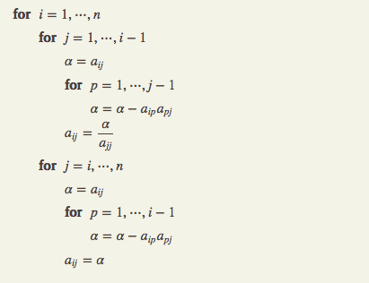

Slide 13
Experiment Setup
Algorithm setup
In-place algorithm, original matrix will be overwritten
Lower matrix L is a unit matrix
3rd part library
cuBlas for matrix ops
Environment setup
Ubuntu 16.04
GPU - GTX 960

Slide 14
Performance Evaluation
Matrix Size (m x n) | Avg time for 1st set of 10 runs (uS) | Avg time for 2nd set of 10 runs (uS)
size 10 | 1,220 | 1,184
size 100 | 5,025 | 4,380
size 1,000 | 40,326 | 39,414
size 10,000 | 2,151,017 | 2,083,625

Slide 15
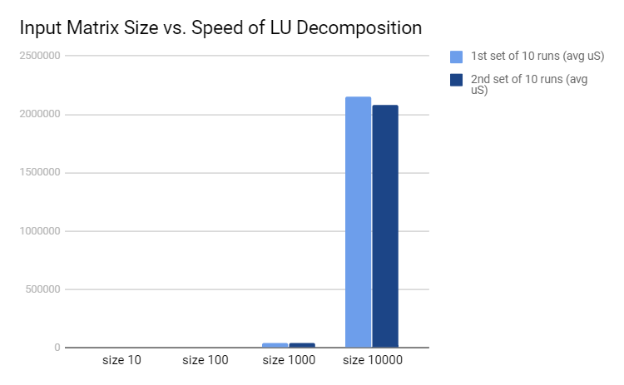
Performance Evaluation Cont.

Slide 16
DEMO

Slide 17
Future work
Multiple CPUs with GPUs
MPI with GPU for large matrix ( > 100,000 x 100,000 ~ 80 GB data)

Slide 18
Conclusion
Block LU Decomposition is an efficient way to solve linear systems of equations
Parallelism execution at standard LU decomposition, matrix multiplication speeds up the computational time
LU factorization is implemented on CUDA and its performance shows promising results on small sets of data
Future study would include benchmarking the algorithm with larger size of input test data, and improve the efficiency of the algorithm by experimenting using MPI and GPU

Slide 19
Q & A

